Slide 1
CoPilot Safe Assist
Software Engineering 2: Project Teamwork
Mälardalen University
Optimus Octavian

Slide 2
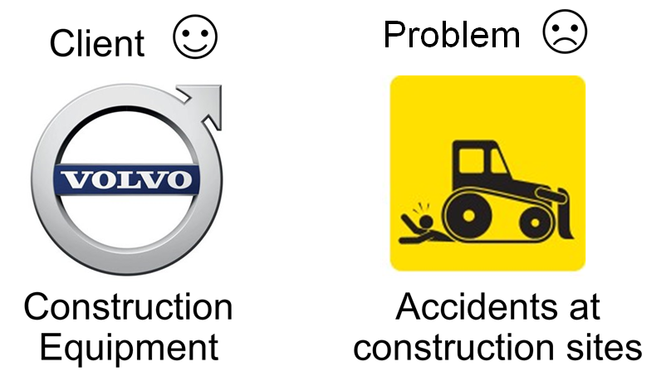
Brief overview

Slide 3
Requirements
Safe Assist should work on hand-held Android mobile device and the Volvo CoPilot System ✓
Should issue an alert when the worker enters in a construction area ✓
Should issue a warning alert when a worker is too close to a vehicle for both the worker and machine operator ✓
Working areas should be defined in the app ✓
The app should have a lower power consumption when a device is outside a construction area ✓
Not issue alert when the workers approaches to his machine ✓

Slide 4
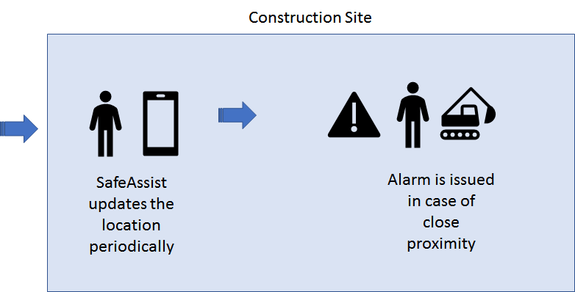



Slide 5
High-level design
Notes:
Will be going over the project architecture, ER-model and the class diagram for the application. I’ll also briefly go over the technologies used.

Slide 6
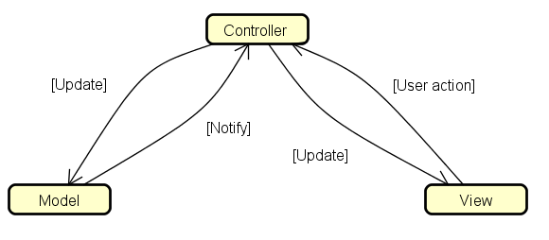
Structure
Notes:
Model-View-Controller theme. The app gives the input to the server which updates the database and receives new data that sets the behaviour of the app. The user logs in and this means data is passed to the controller from the view. The controller sorts out the parts needed by the database/server and sends it (model). Model does some checking and sends a response back to the controller which in turn decides how the view should act.

Slide 7
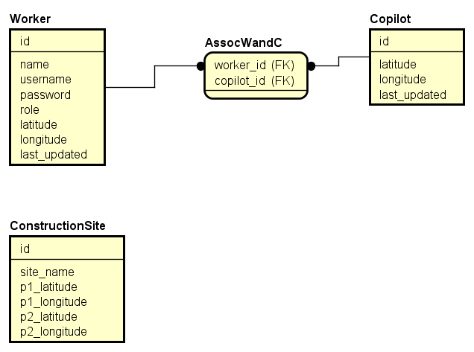
ER-model
Notes:
Intentionally pretty self-explanatory. We have the id’s from the worker- and copilot-tables in an association to set the behaviour for any worker operating a vehicle so that aforementioned “operator” does not get incessant proximity-warnings for said vehicle. And then there’s the table for the area, this is set using the website.

Slide 8
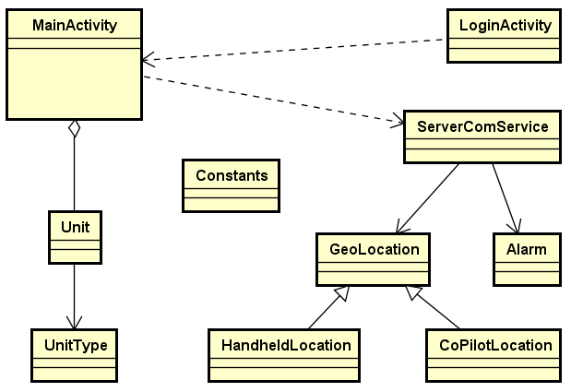
Class- diagram
Notes:
When you start the app you are in the LoginActivity, from which you are then forwarded to MainActivity which uses the ServerComService to maintain the functionality if the application is put in the background. Constants contains simple variables which are, constant… Unit is the baseclass from which the UnitType is derived. UnitType sets the behaviour (handheld/copilot). Which means that the ServerComService uses the derived classes handheld- copilot-location-classes depending on UnitType. Alarm is the class that sets the severity of the alarm depending on the response from the database through ServerCom.

Slide 9
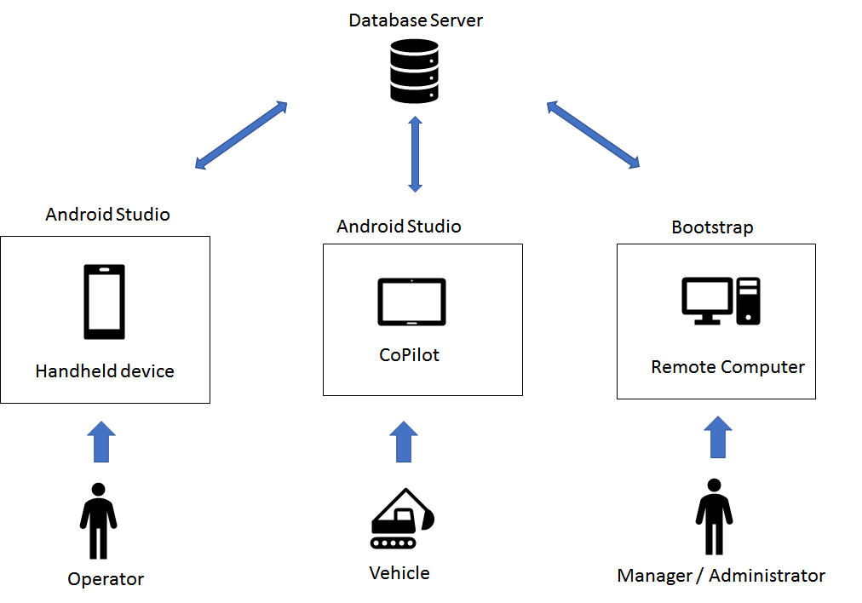
Tech
Notes:
Hardware: Smartphones, CoPilot, Volvo-simulator, laptops.
Software: SQL, Java, Bootstrap
We are currently using android smartphones, CoPilot and computers as far as hardware is concerned. Regarding software technology we’re using Java, sql, html, css, javascripts and php. We’ve been using IDE’s like Android Studio and frameworks such as bootstrap.

Slide 10
Quality insurances
How did you ensure the important qualities (e.g. real-time behaviour, security)?
Keyword: Agile
Planning high-priority tasks
Checking requirements
Implement
Test
Rinse and repeat
Security, is that edible? Maybe with butter?
Notes:
By agile planning, implementing and testing within the restrictions set by ourselves to achieve the most important requirements.
The security parameters was not seen as a priority, at best secondary, compared to having an app that fulfilled the functional requirements.
Real-time behaviour have been tested thoroughly by ourselves, wandering about setting our devices to be workers or vehicles.
In other words, security was not a requirement and as such, not something we focused on. We are using a simple login feature for the sake of having a login-feature, but it’s not fancy in any way since Volvo would be using one of their own anyway.

Slide 11
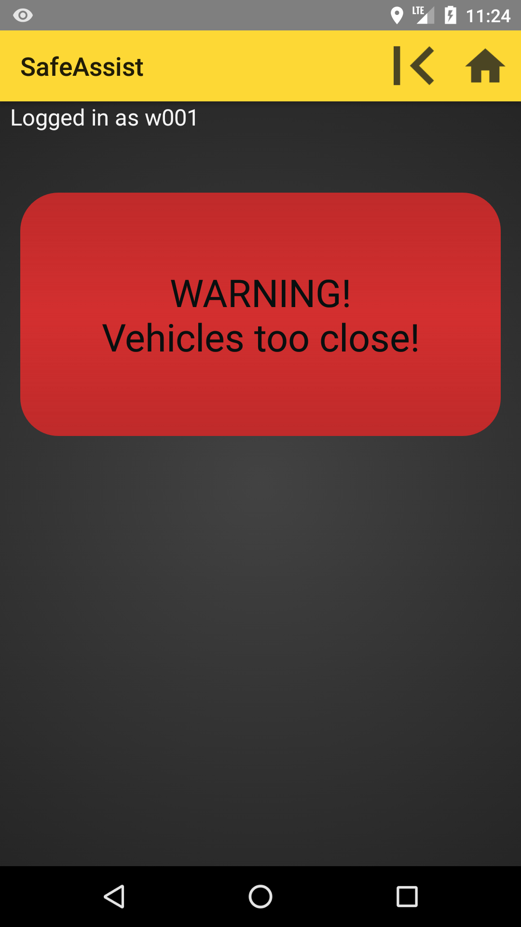
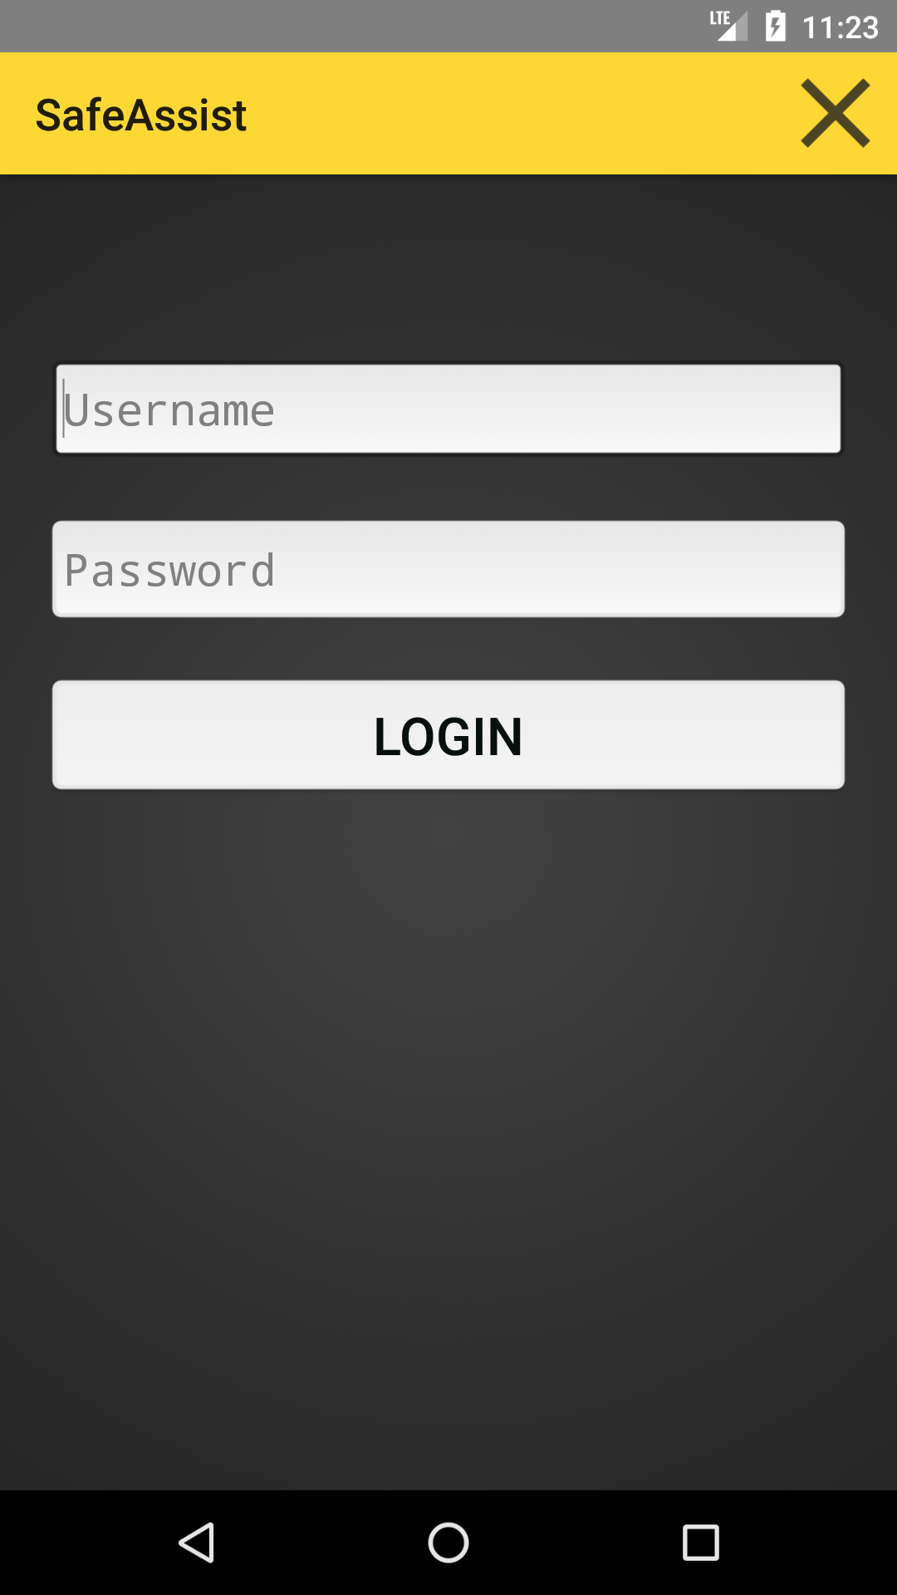
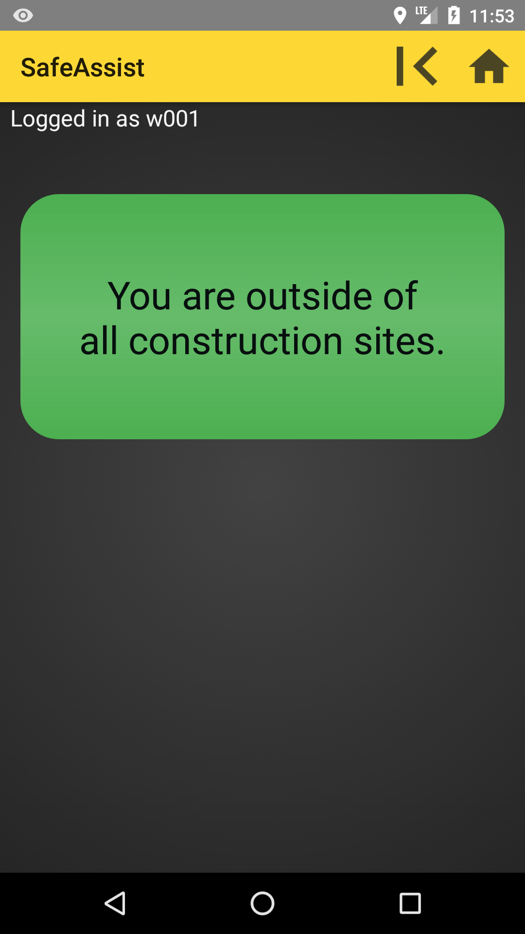
Result demonstration
Notes:
The app looks the same for both handheld Android devices and the CoPilot. Thus it is easy for the users to go from one to the other.

Slide 12
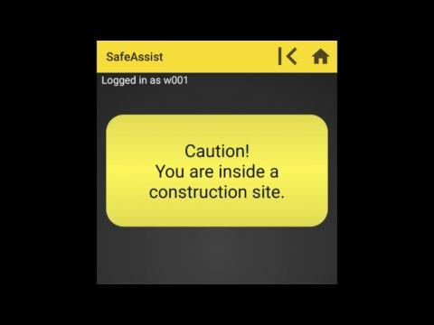
Notes:
A short video that shows the concept and our final result.

Slide 13

Login
Notes:
To activate SafeAssist the user needs to login.
On a CoPilot the driver logs in with the same credentials as on the handheld device. However, the functionality in the app is different. Entering credentials on a CoPilot will associate the drivers handheld device with that CoPilot.

Slide 14
Outside construction site
Notes:
As the worker is still outside, the app also says so.

Slide 15
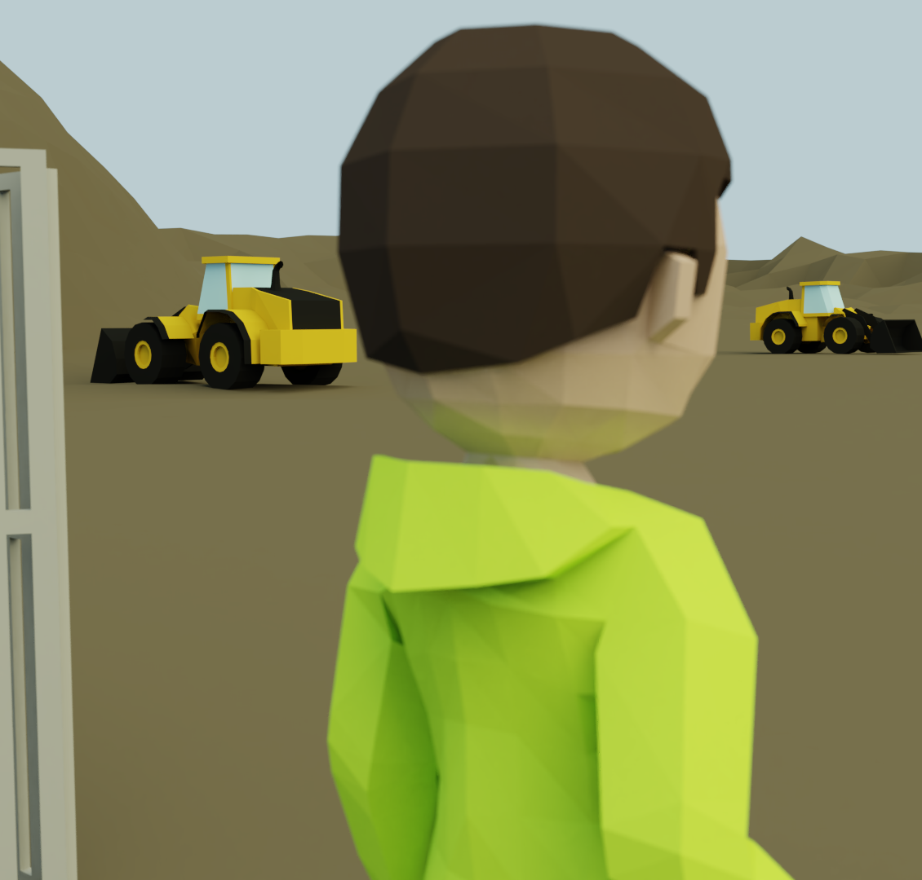
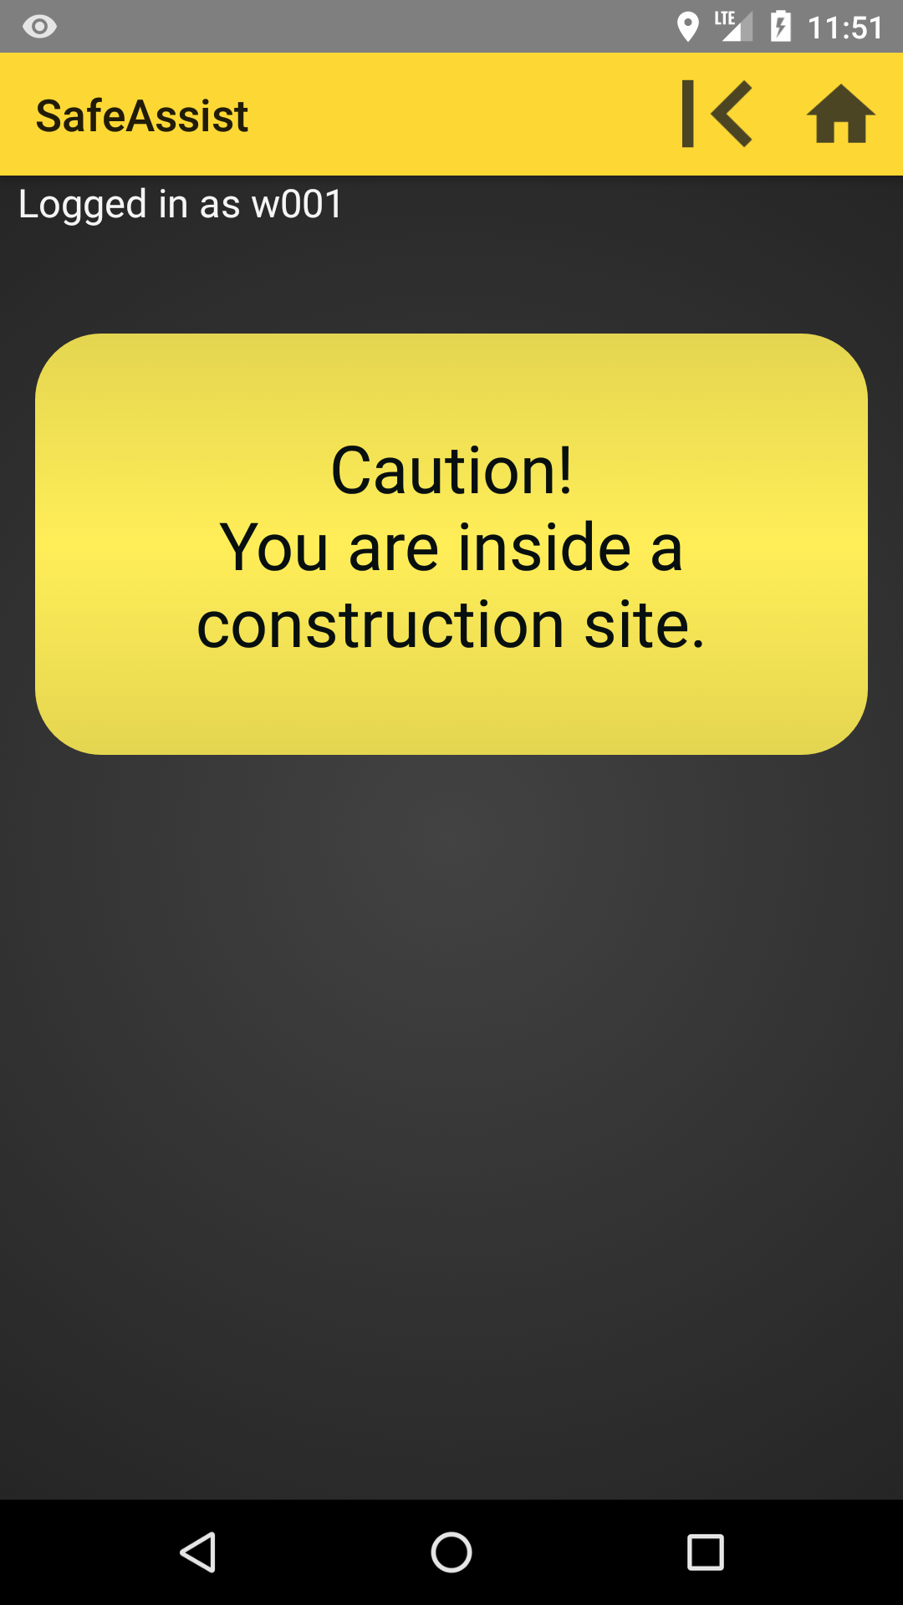
Inside construction site
Notes:
As soon as the worker enters the construction site, he gets a notification about that. This is a feature is there to remind the worker, but maybe primarily because not all constructions site have visible fences or boundaries.

Slide 16
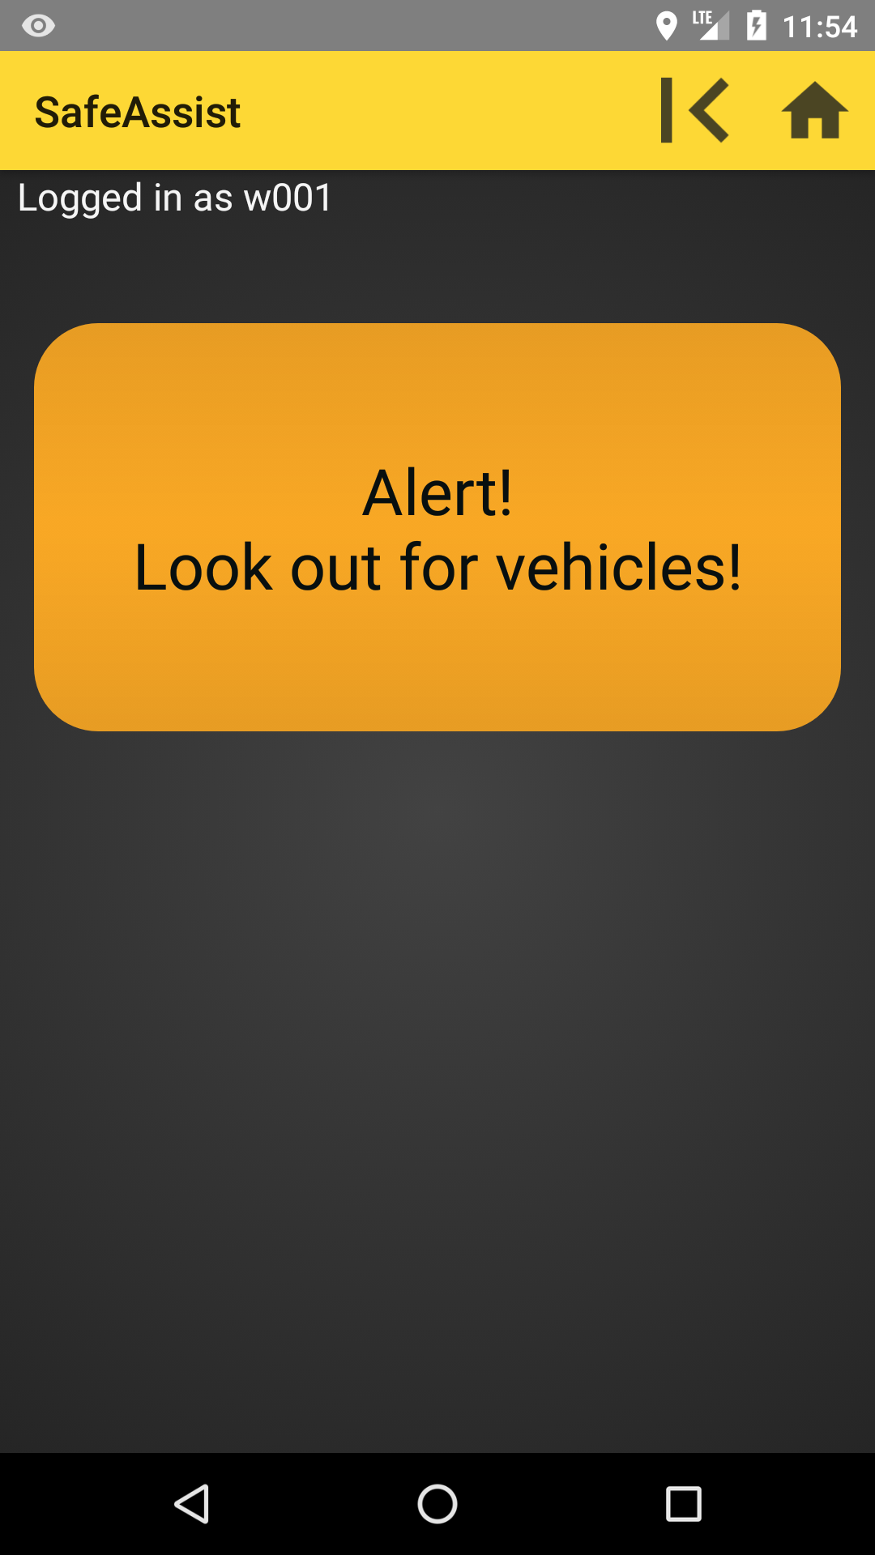

Close to a vehicle
Notes:
When SafeAssist notices that an other unit is close it will alert the worker to look out for vehicles.

Slide 17
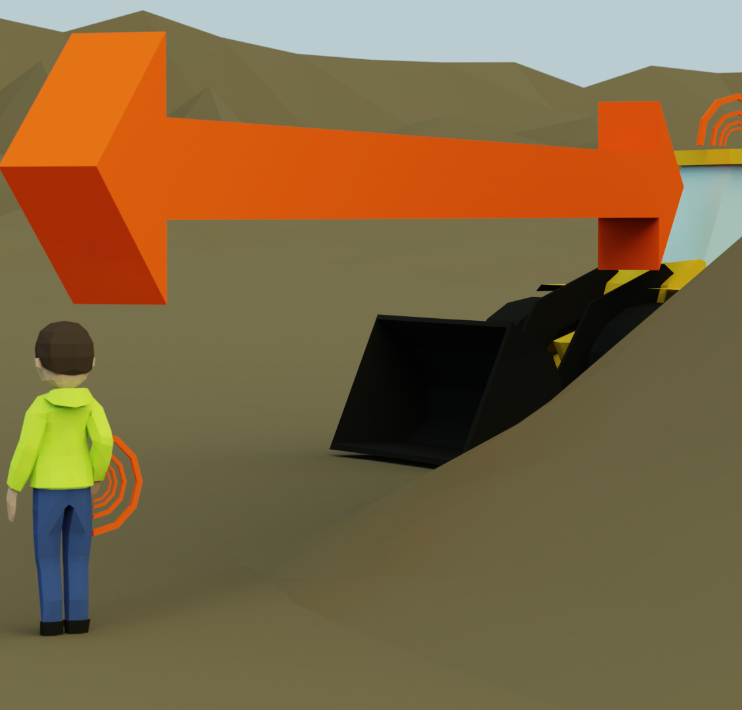
Too close to a vehicle
Notes:
At a certain distance SafeAssist goes in to the highest Alert mode.

Slide 18
Features
Proximity alert, worker-vehicle and vehicle-vehicle
User login and logout
Notifying a worker as (s)he enters a construction site
Associating a worker with a machines CoPilot
A “send application to background” button (needed in CoPilot)
Web interface for managing users and constructions sites

Slide 19
Project Work
Followed the initial plan, with a few exceptions
Revised requirements
More tests earlier in the process
Acceptance test was delayed a week
No time planned for learning CoPilot API
Notes:
Our initial plan overall held well. We had some changes along the way though; we revised the requirements multiple times after meetings with our client, we conducted testing earlier than planned on unit and integration level and the acceptance testing got delayed due to implementation issues. And we did not plan any time for learning and understanding the simulator and the CoPilot API, which turned out to be nontrivial.

Slide 20
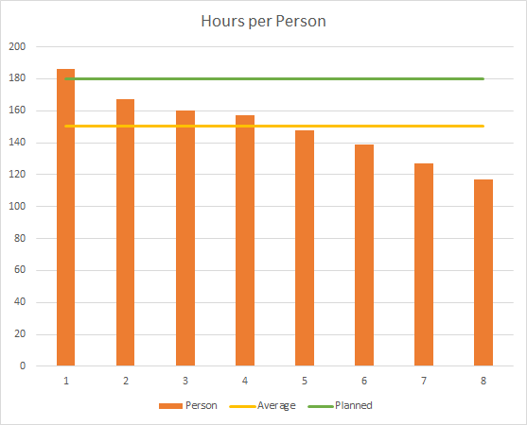
Working Hours
Planned: 1440
Worked: 1200 (as of this morning)
Probable reason for fewer hours:
Overestimation for the holidays
Traveling
Sickness
Notes:
We had estimated 1440 working hours, but as of this morning, we summarize our total working time to 1200 hours. A reason for us not reaching the estimates hours may be an overestimation for the holidays. Other reasons may be that some of us were traveling and lastly that we had some sickness in the group.

Slide 21
Team Organization
Two meetings per week
Planning
Summarizing
Synchronization
Reorganization halfway into the project
Focus groups
Handheld device
CoPilot
Web
Notes:
During this project our groups has had two meeting per week. We used them to planned the work for the given week, summarized the previous week and synchronizing the group. After about half the project duration we chose to divide the team into smaller focus groups with different responsibilities. That turned out to increase the overall efficiency in the group.

Slide 22
Experiences
Issues?
Expectations
Lessons learned? Holidays are the bluescreen of death for productivity...
Notes:
The more prominent issues was lack of experience of working in a project like this, ie, the lack of understanding of how much time goes into planning and documentation. Lack of experience of dividing up work into smaller tasks (meaning workload measured in hours) and that having a clear leadership to keep the group on track helps a lot. We expected to be able to deliver a functional prototype and we have met that expectation. Things that we will take with us for the next project is to not underestimate the time required for planning, to keep people on track with where the project is and not steer off into implementation-stuff on the first day, and to divide up work into even smaller parts.

Slide 23
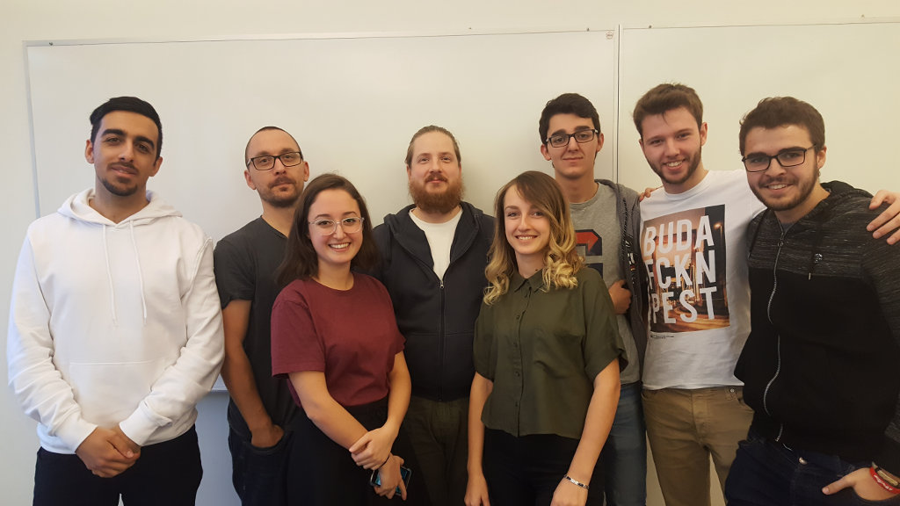
Thank you for your time!
Dara
Rickard
Fernando
Vasja
Jonas
Sidorela
Pablo
Alvaro

